Slide 1

Rockbuster Stealth Online Launch Strategy
By: Heather Stewart

Slide 2
Objective
Rockbuster Stealth LLC is a movie rental company. Currently, the company is facing stiff competition from its online streaming competitors such as Netflix and Amazon Prime; therefore, Rockbuster Stealth is planning on using its existing movie licenses to launch online video rental services.
Notes:
© Copyright PresentationGO.com – The free PowerPoint and Google Slides template library

Slide 3






Probing Questions
Which countries are Rockbuster customers based in?
Where are customers with high lifetime value based?
Do sales figures vary between geographic regions?
Which movies contributed the most/least to revenue gain?
What was the average rental duration for all videos?

Slide 4

Movies Statistics
The Minimum, Maximum and Average by Movie Categories.
These categories affect the growth of revenue and customers willingness to rent.
Categories | Minimum | Maximum | Average
Rental Rate | $.99 | $4.99 | $2.98
Rental Duration | 3 days | 7 days | 5 days
Replacement Cost | $9.99 | $29.99 | $19.98
Length of movie | 46 mins | 185 mins | 115 mins

Slide 5
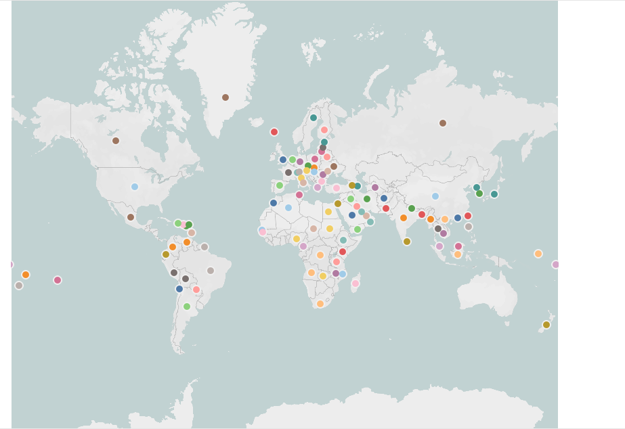




Customers by Locations, Count and Revenue
The number of customers are geographically concentrated in Asia, Africa and America.
Number of Countries: 108
Total number of customers: 599
Total Revenue: ~$62,000

Slide 6
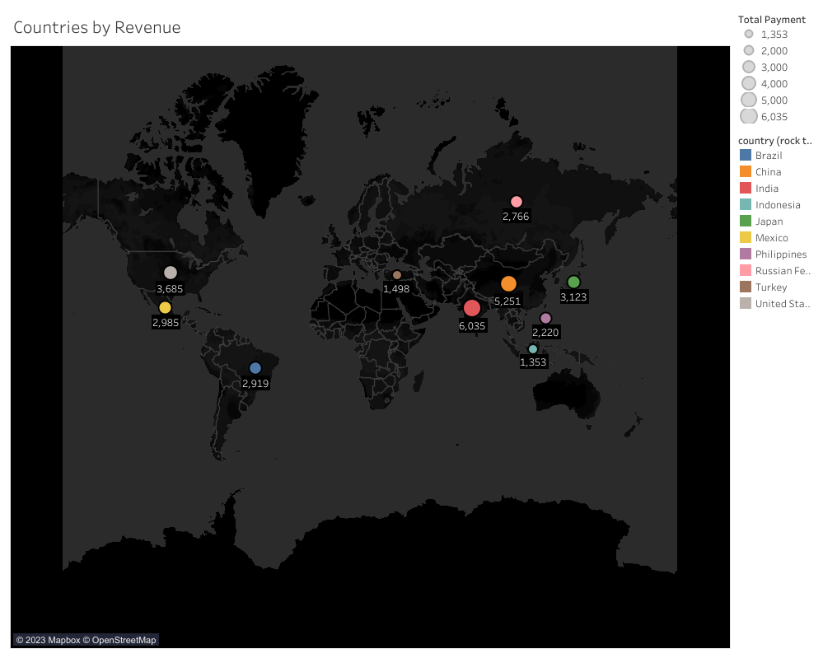
Top 10 Countries by Customer Count & Revenue
India, China, USA and Japan generate 50% of the revenue having the largest number of customers combine.
Countries | Customer count | Revenue
India | 60 | $6,035
China | 53 | $5,251
USA | 36 | $3,685
Japan | 31 | $3,123
Mexico | 30 | $2,985
Brazil | 28 | $2,919
Russian Fed | 28 | $2,766
Philippines | 20 | $2,220
Turkey | 15 | $1,498
Indonesia | 14 | $1,353

Slide 7

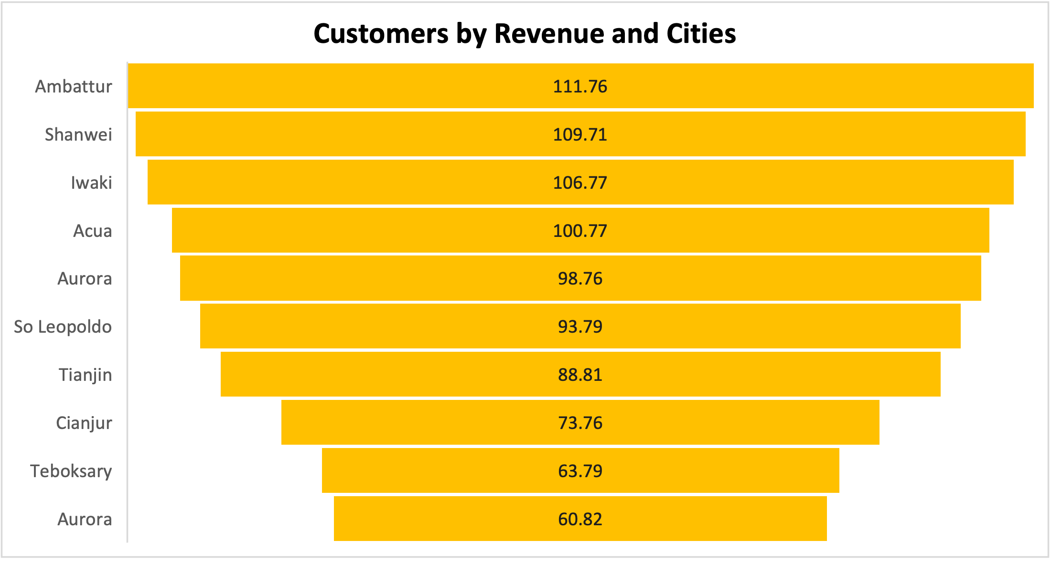
Customers With High lifetime Value by City and Revenue
Arlene, Kyle, Marlen and Glen are customers with the highest revenue in their cities. Exemplifying their loyalty.

Slide 8

Top Grossing and Most Watched Actors
Susan, Gina and Matthew are the most
watched actors and should have higher sourcing advantage.
Most watched actors Revenue # of Movies
Susan Davis $3,200 750
Gina DeGeneres $3,100 685
Matthew Carrey $2,500 619

Slide 9
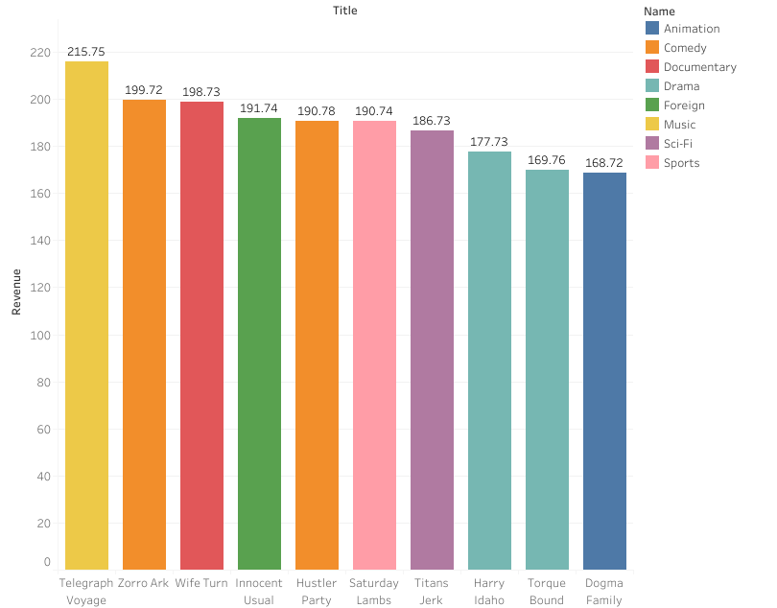
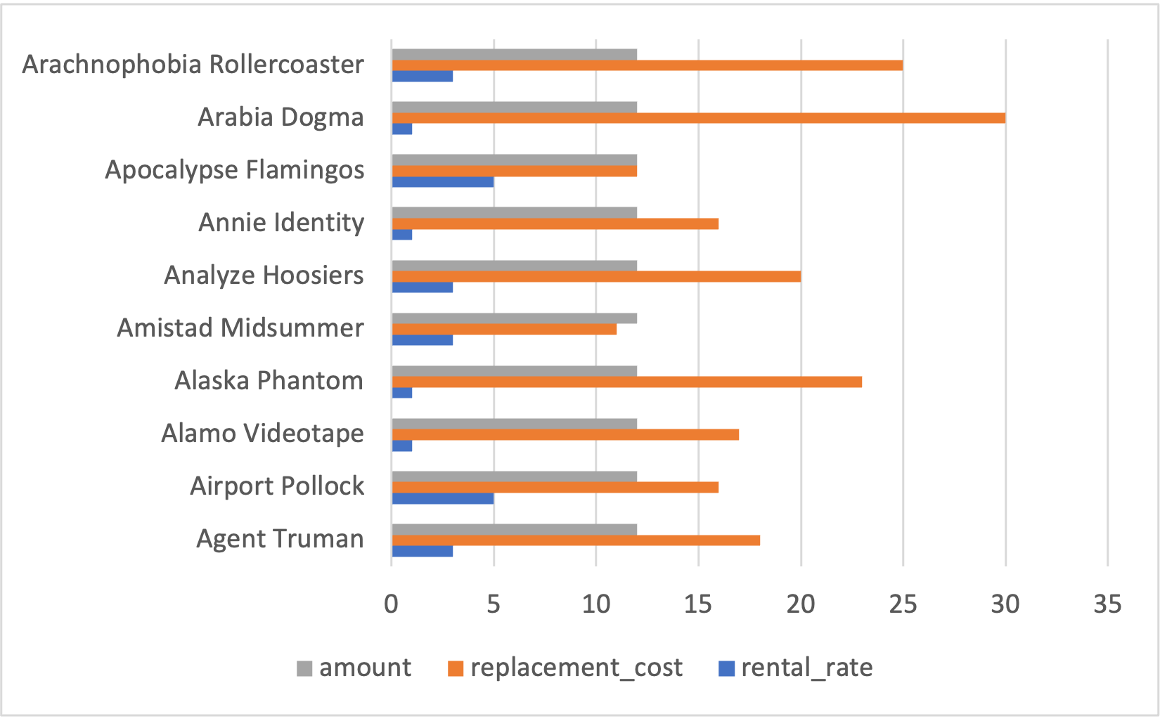
Most Popular Movies by Revenue and Ratings
Total # of movies 1000 with Telegraph (PG) generating the highest revenue, demonstrating similar movie performance.
Telegraph Voyage (PG)= $216 highest revenue
Arabia Dogma (NC-17) = $30 highest replacement cost
Apocalyse Flamingos (R) =$5 highest rental rate

Slide 10
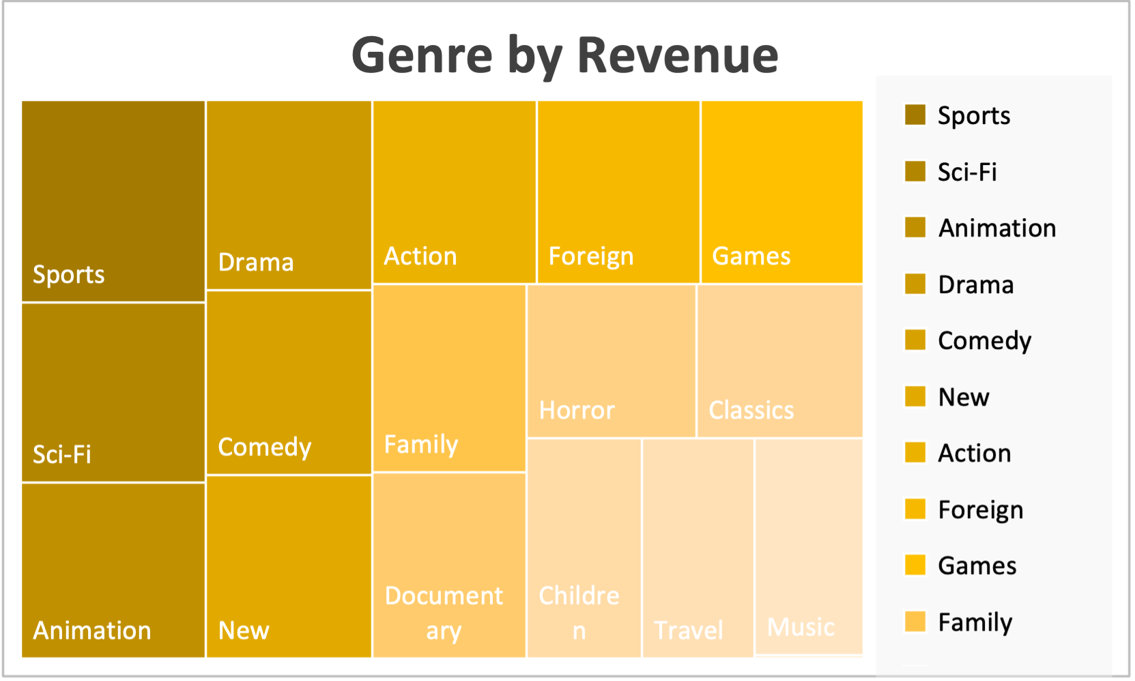

Genre by Revenue and Ratings by Count
Sports, Sci-Fi & Animation generate the highest revenue per ratings among the genres and should dominate the catalog.
Ratings | Number of Ratings
NC-17 | 210
PG-13 | 223
R | 195
G | 178
PG | 194

Slide 11
Recommendations
Increase Revenue
Increase selection for movies in Genre of Sport, Sci-Fi, Animation, Drama, Comedy, New, Action, Foreign, Games and Family
Increase selection in Ratings: PG-13, NC-17, R, G, and PG
Increase selection with Actors: Susan Davis, Gina Degneres, Carrey, Matthew Carrey, Mary Keitel, Scarlett Damon, Walter Torn, Henry Berry, Christian Akroyd, Angela Witherspoon and Cameron Zellweger
Increase Brand Recognition
Increase advertisment in: India, China, United States, Japan, Mexico, Brazil, Russian Federation, Phillipines, Turkey, and Indonesia to increase market share
Increase Customers
Offer incentives such loyalty program, 25% off second rental to customers with highest rental volume.
Offer customers with low rental volume 50% off second rental within a time frame to scale rental volume and loyalty
Next Steps
Create survey to capture customers’ satisfaction
Increase advertisement in countries with low/no customer volumes to expand market
Notes:
© Copyright PresentationGO.com – The free PowerPoint and Google Slides template library

Slide 12

Thank You!
Questions and Answers
https://public.tableau.com/app/profile/heather.stewart1180/viz/RockbusterStealthProject_17001739446530/CountriesbyRevenues

